Slide 1
Examining the sensitivity of sewage network surveillance sampling plans using simulation models
Accra, Ghana
Wolfgang & Andrew
Notes:
Wolfgang Mairinger

Slide 2
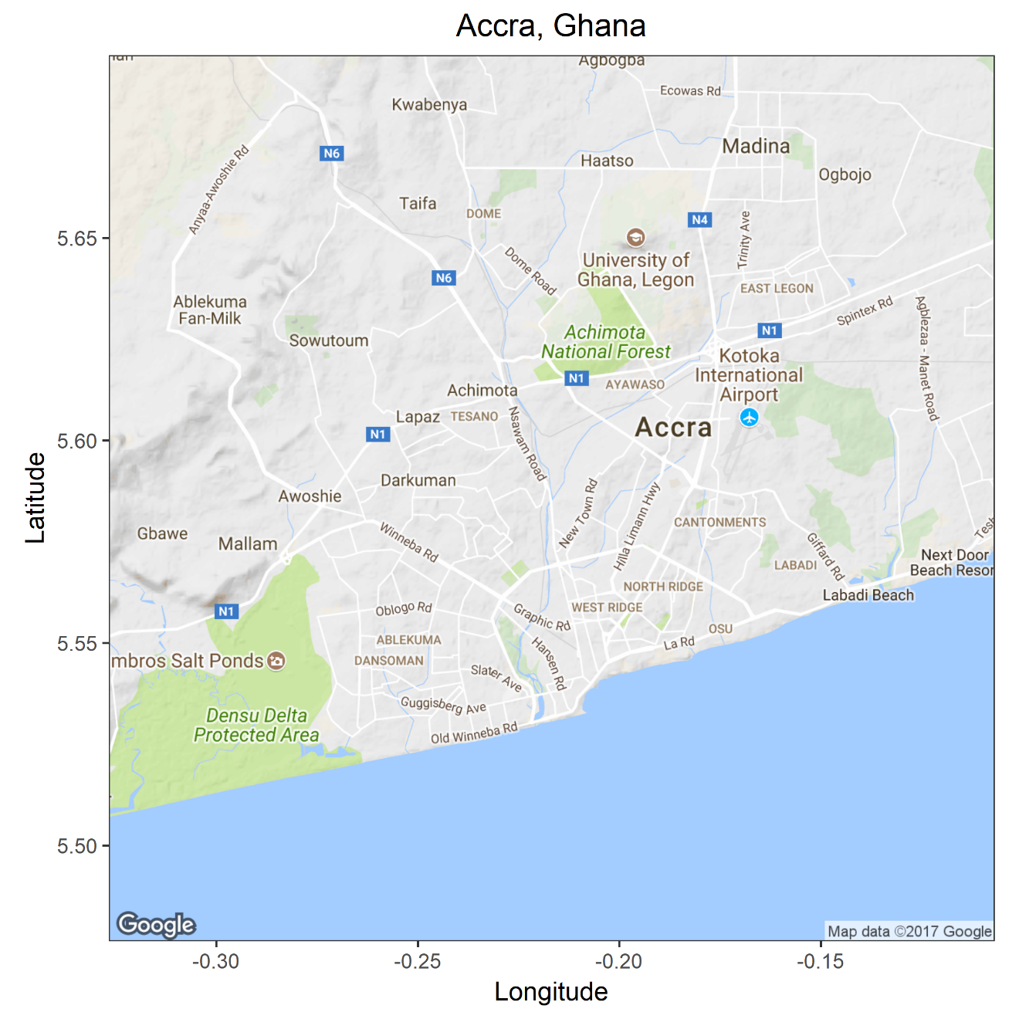
Accra, Ghana
Greater Accra Area:
Population: 4.6 Mio
Accra:
Population: 1.7 Mio
Households: 481,000
People per HH: 3.8
Population Density: 12,583 people /km²
Liquid waste disposal into sewage 11%
Source: Ghana Statistical Service

Slide 3
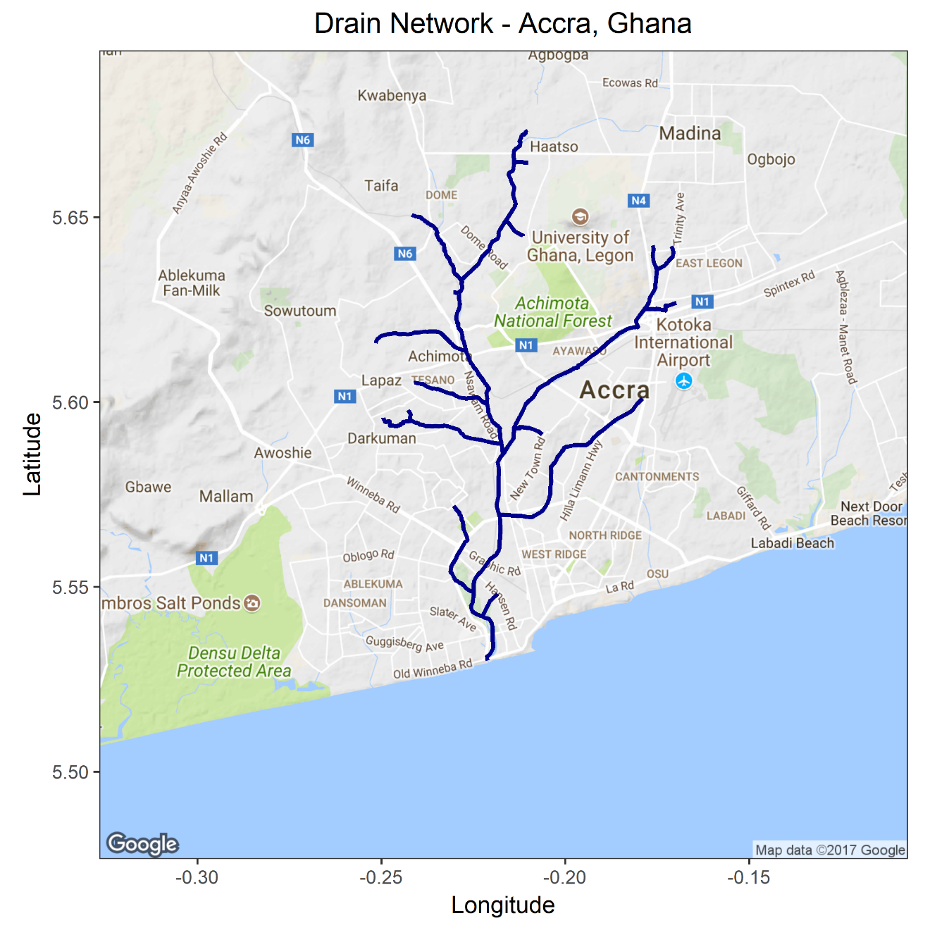
Drain Network
One main drain was selected that covers most of the neighborhoods in the city.

Slide 4
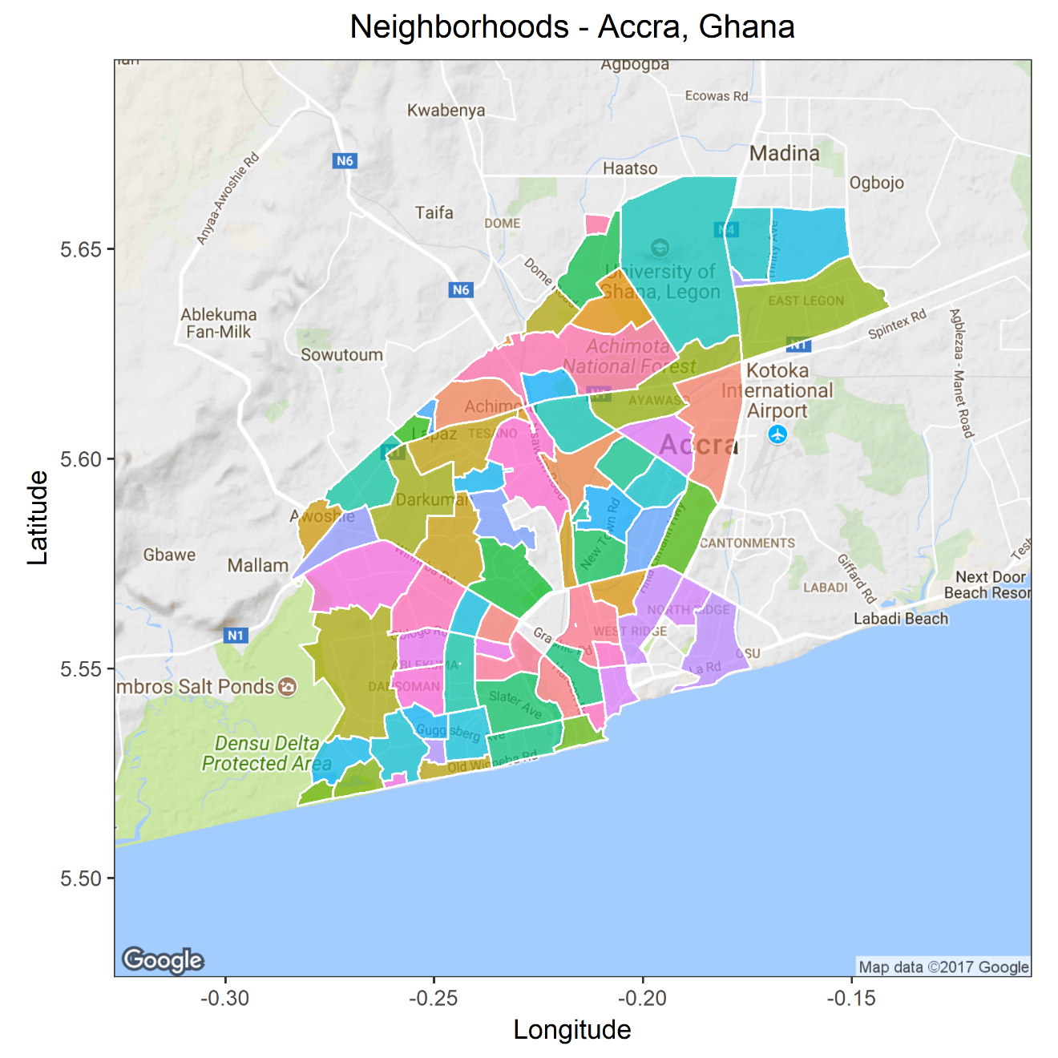
Neighborhoods

Slide 5
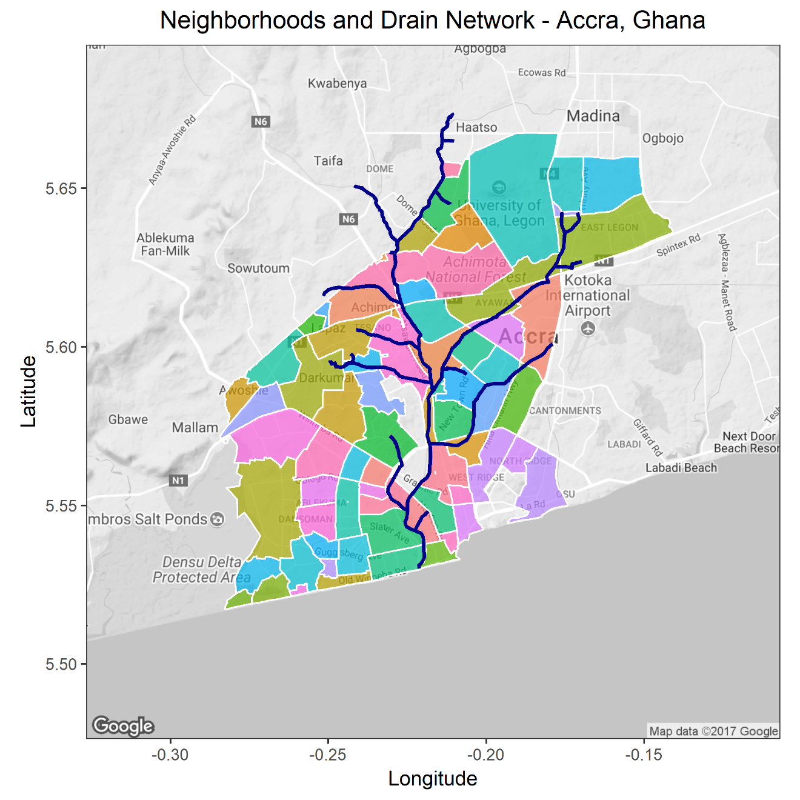
Neighborhoods and Drain Network

Slide 6
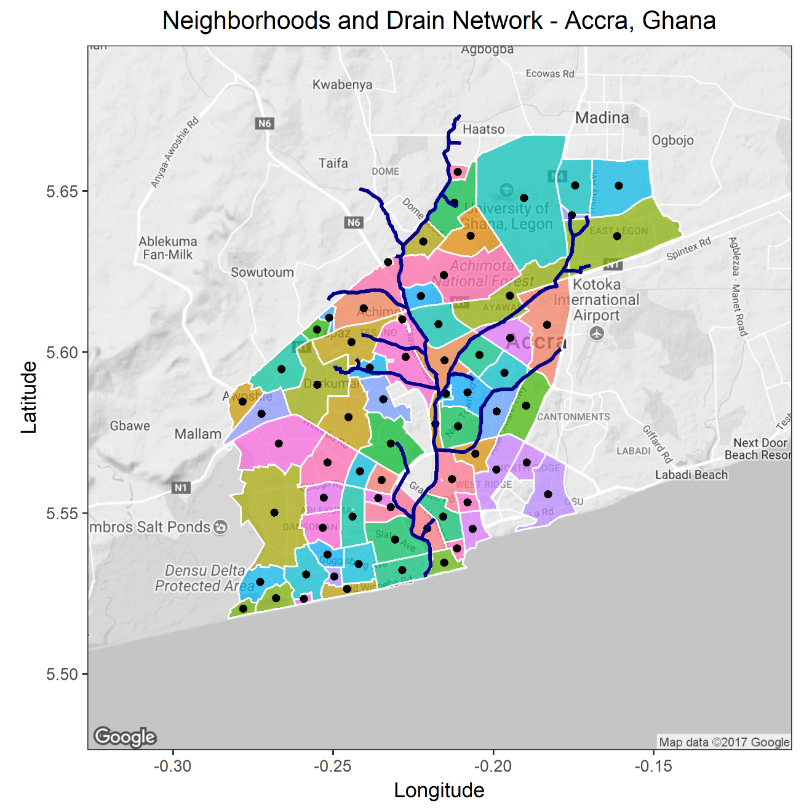
Weighted Mean Center of Neighborhoods
Neighborhood point
Shortest distance to drain

Slide 7
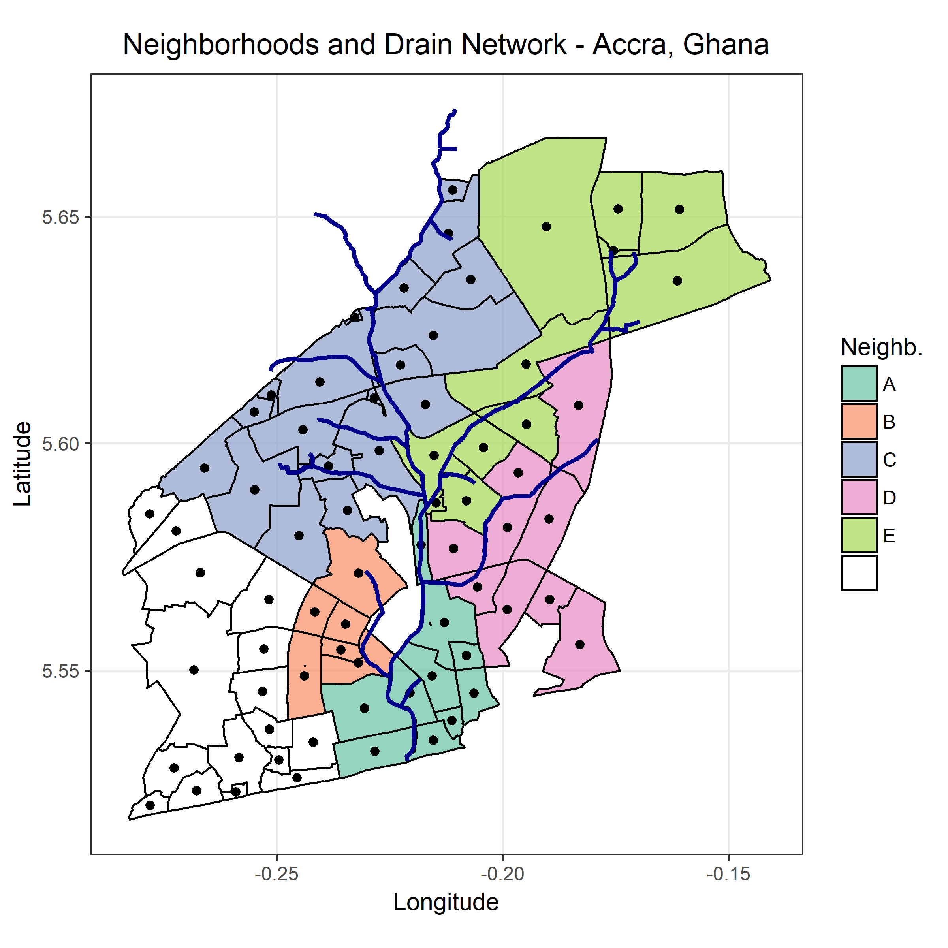
Classification of Neighborhoods

Slide 8
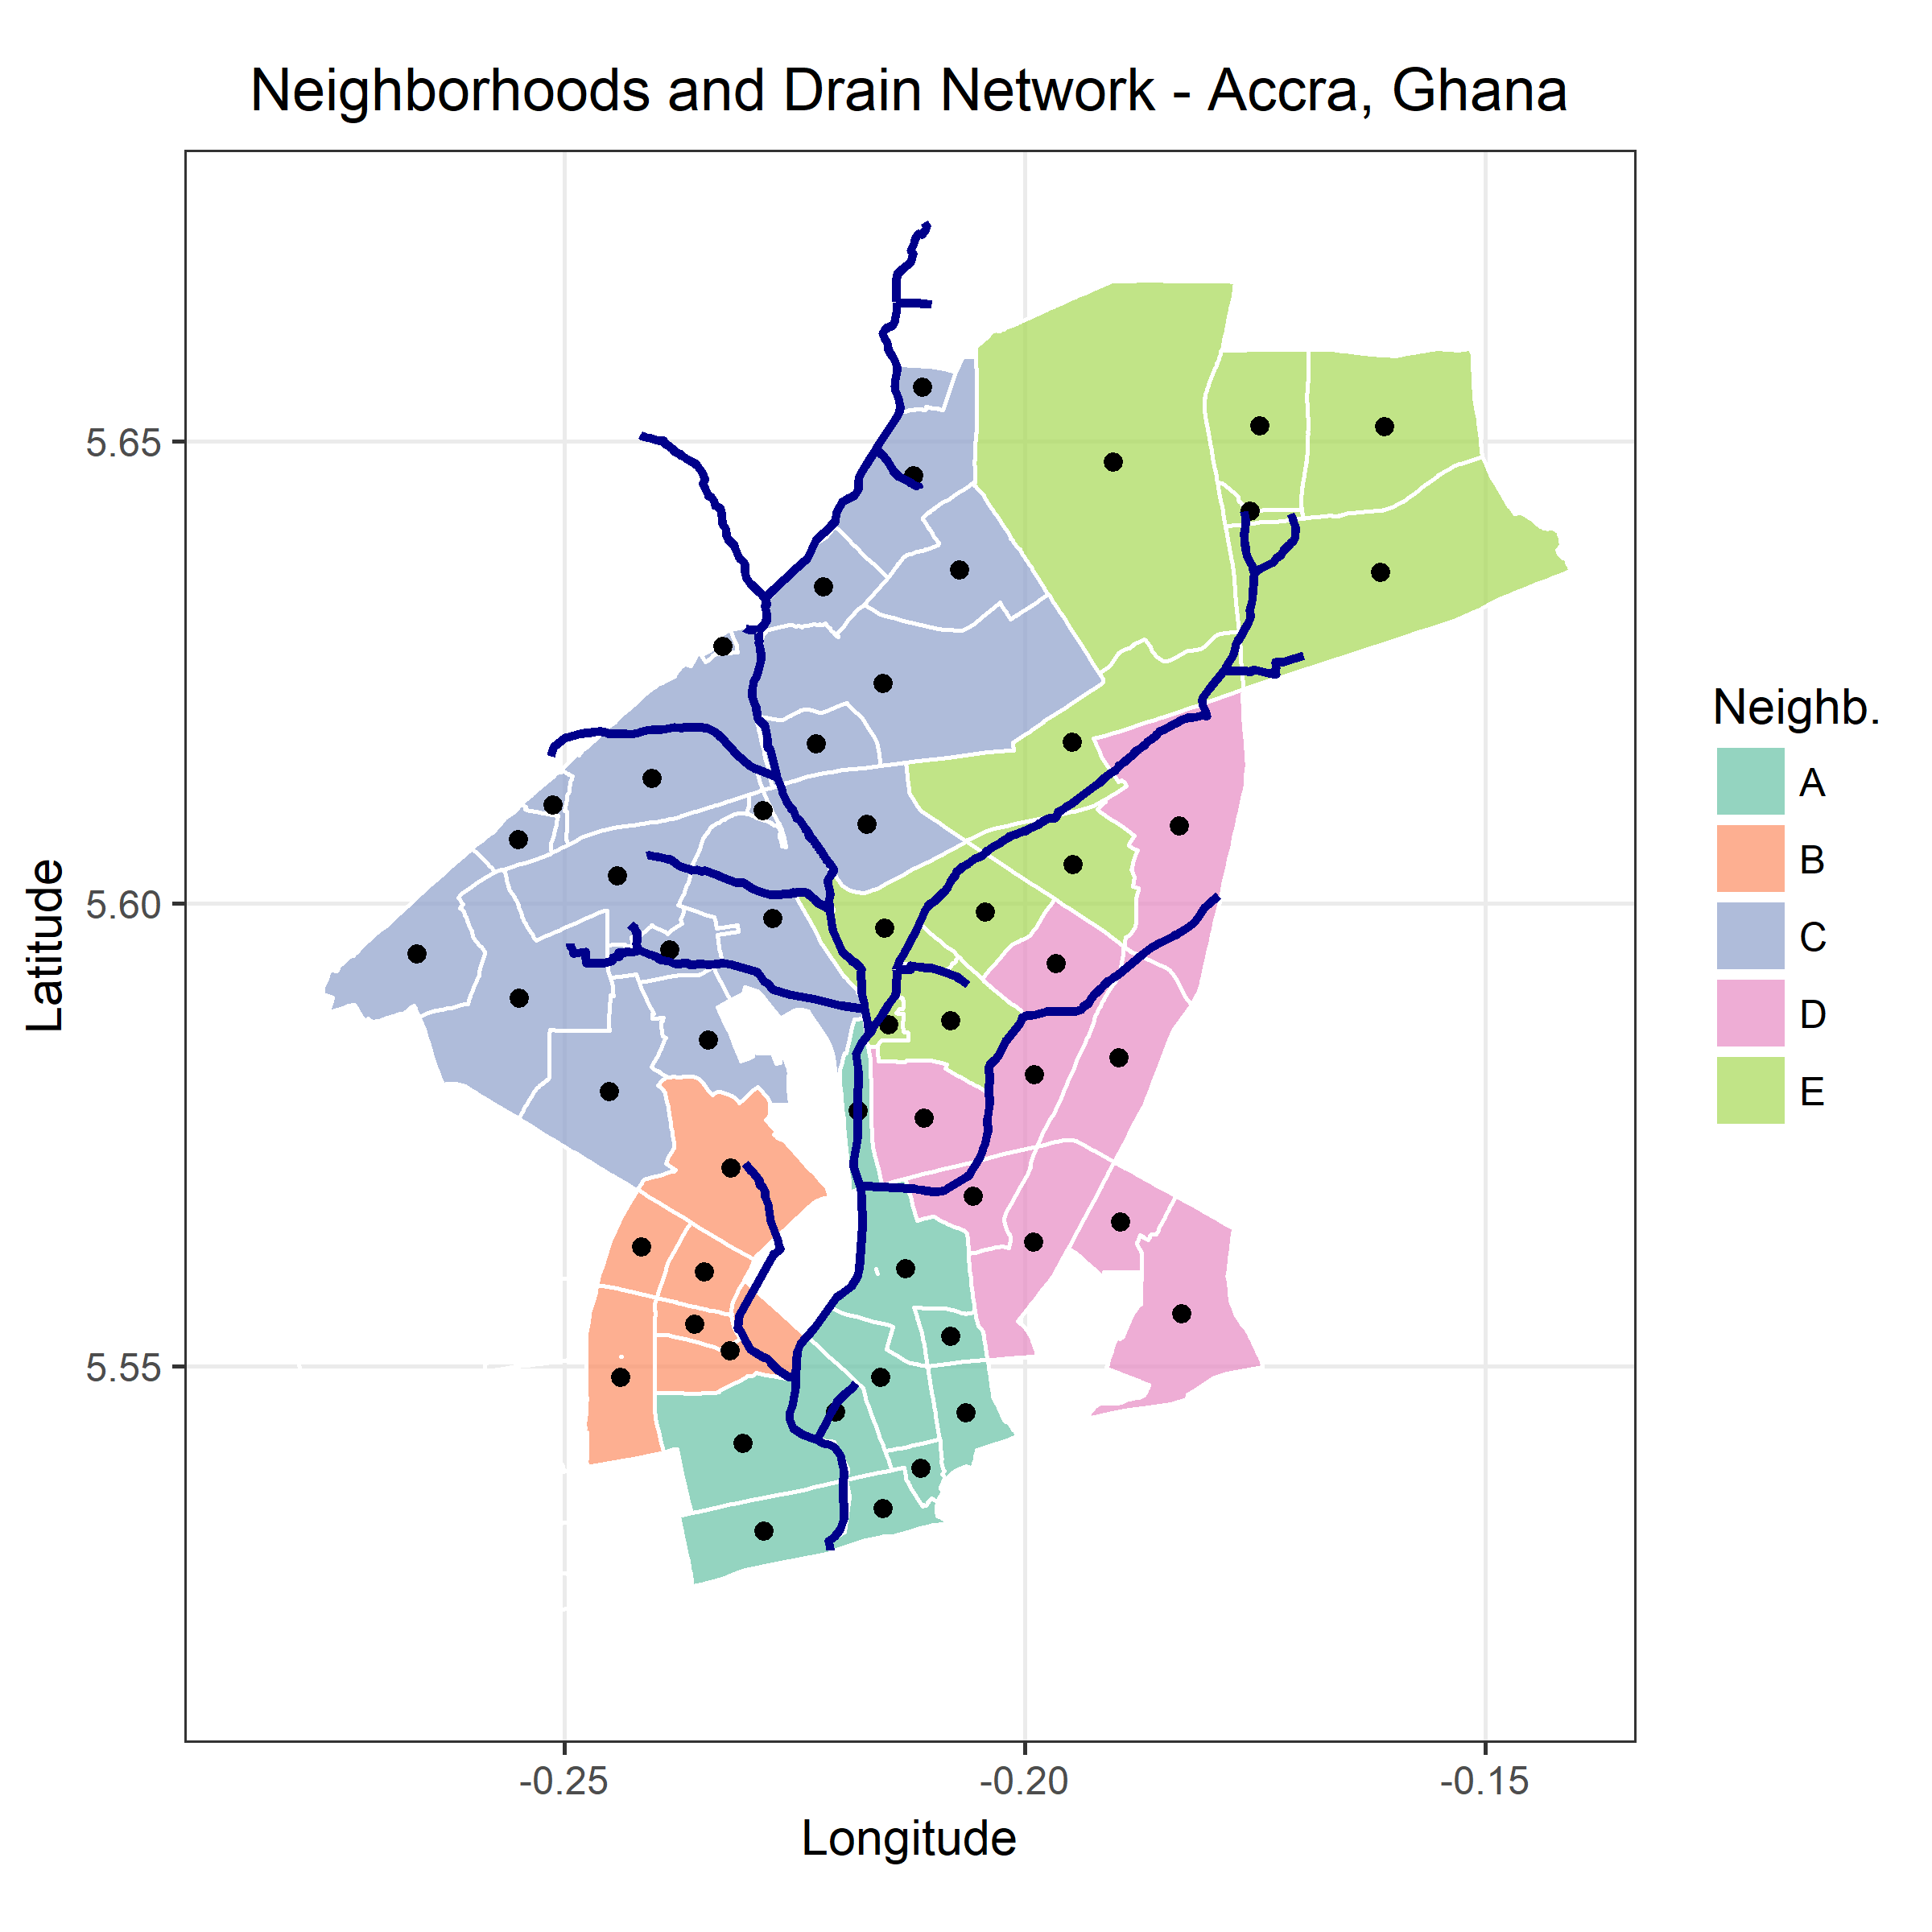
Weighted Mean Center of Neighborhoods

Slide 9

Neighborhoods and Drain Network
Final map

Slide 10
Surveillance Stations
C
E
D
B
A

Slide 11
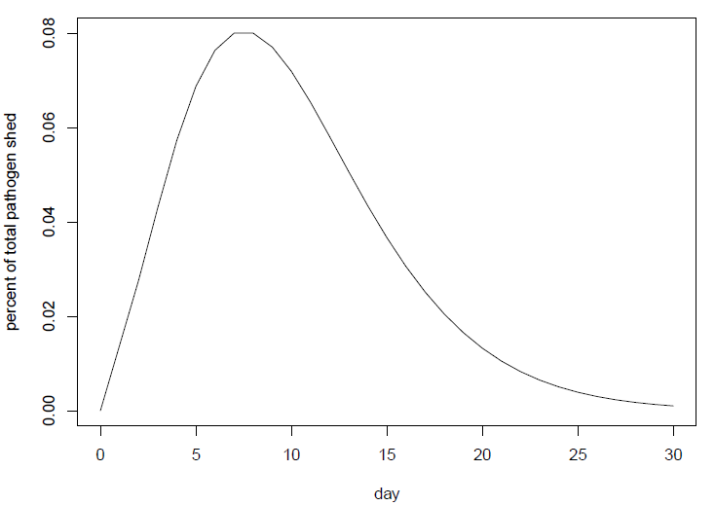
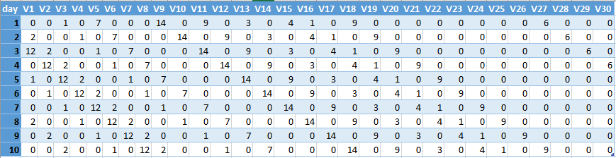
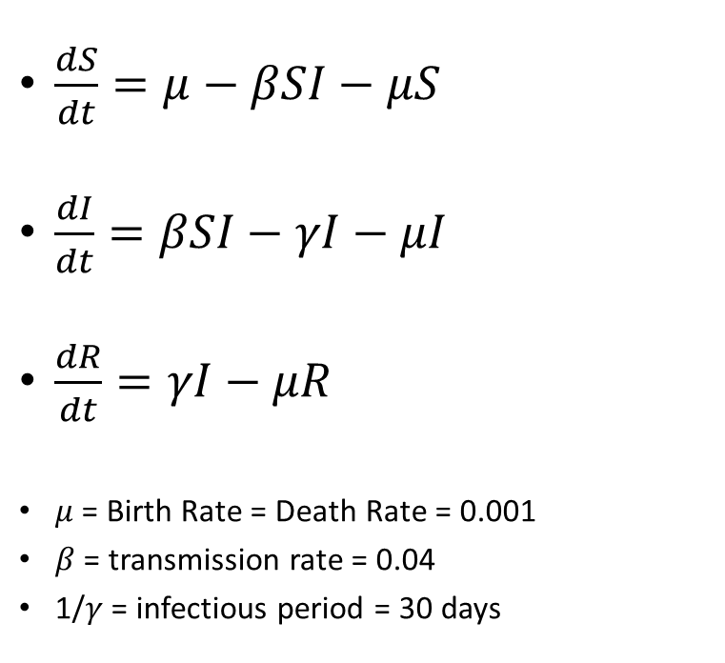
SIR Model
$\frac{dS}{dt}=μ−βSI−μS$
$\frac{dI}{dt}=βSI−γI−μI$
$\frac{dR}{dt}=γI−μR$
$μ$ = Birth Rate = Death Rate = 0.001
$β$ = transmission rate = 0.04
1/$γ$ = infectious period = 30 days

Slide 12
Pathogen Journey
C
E
D
B
A

Slide 13
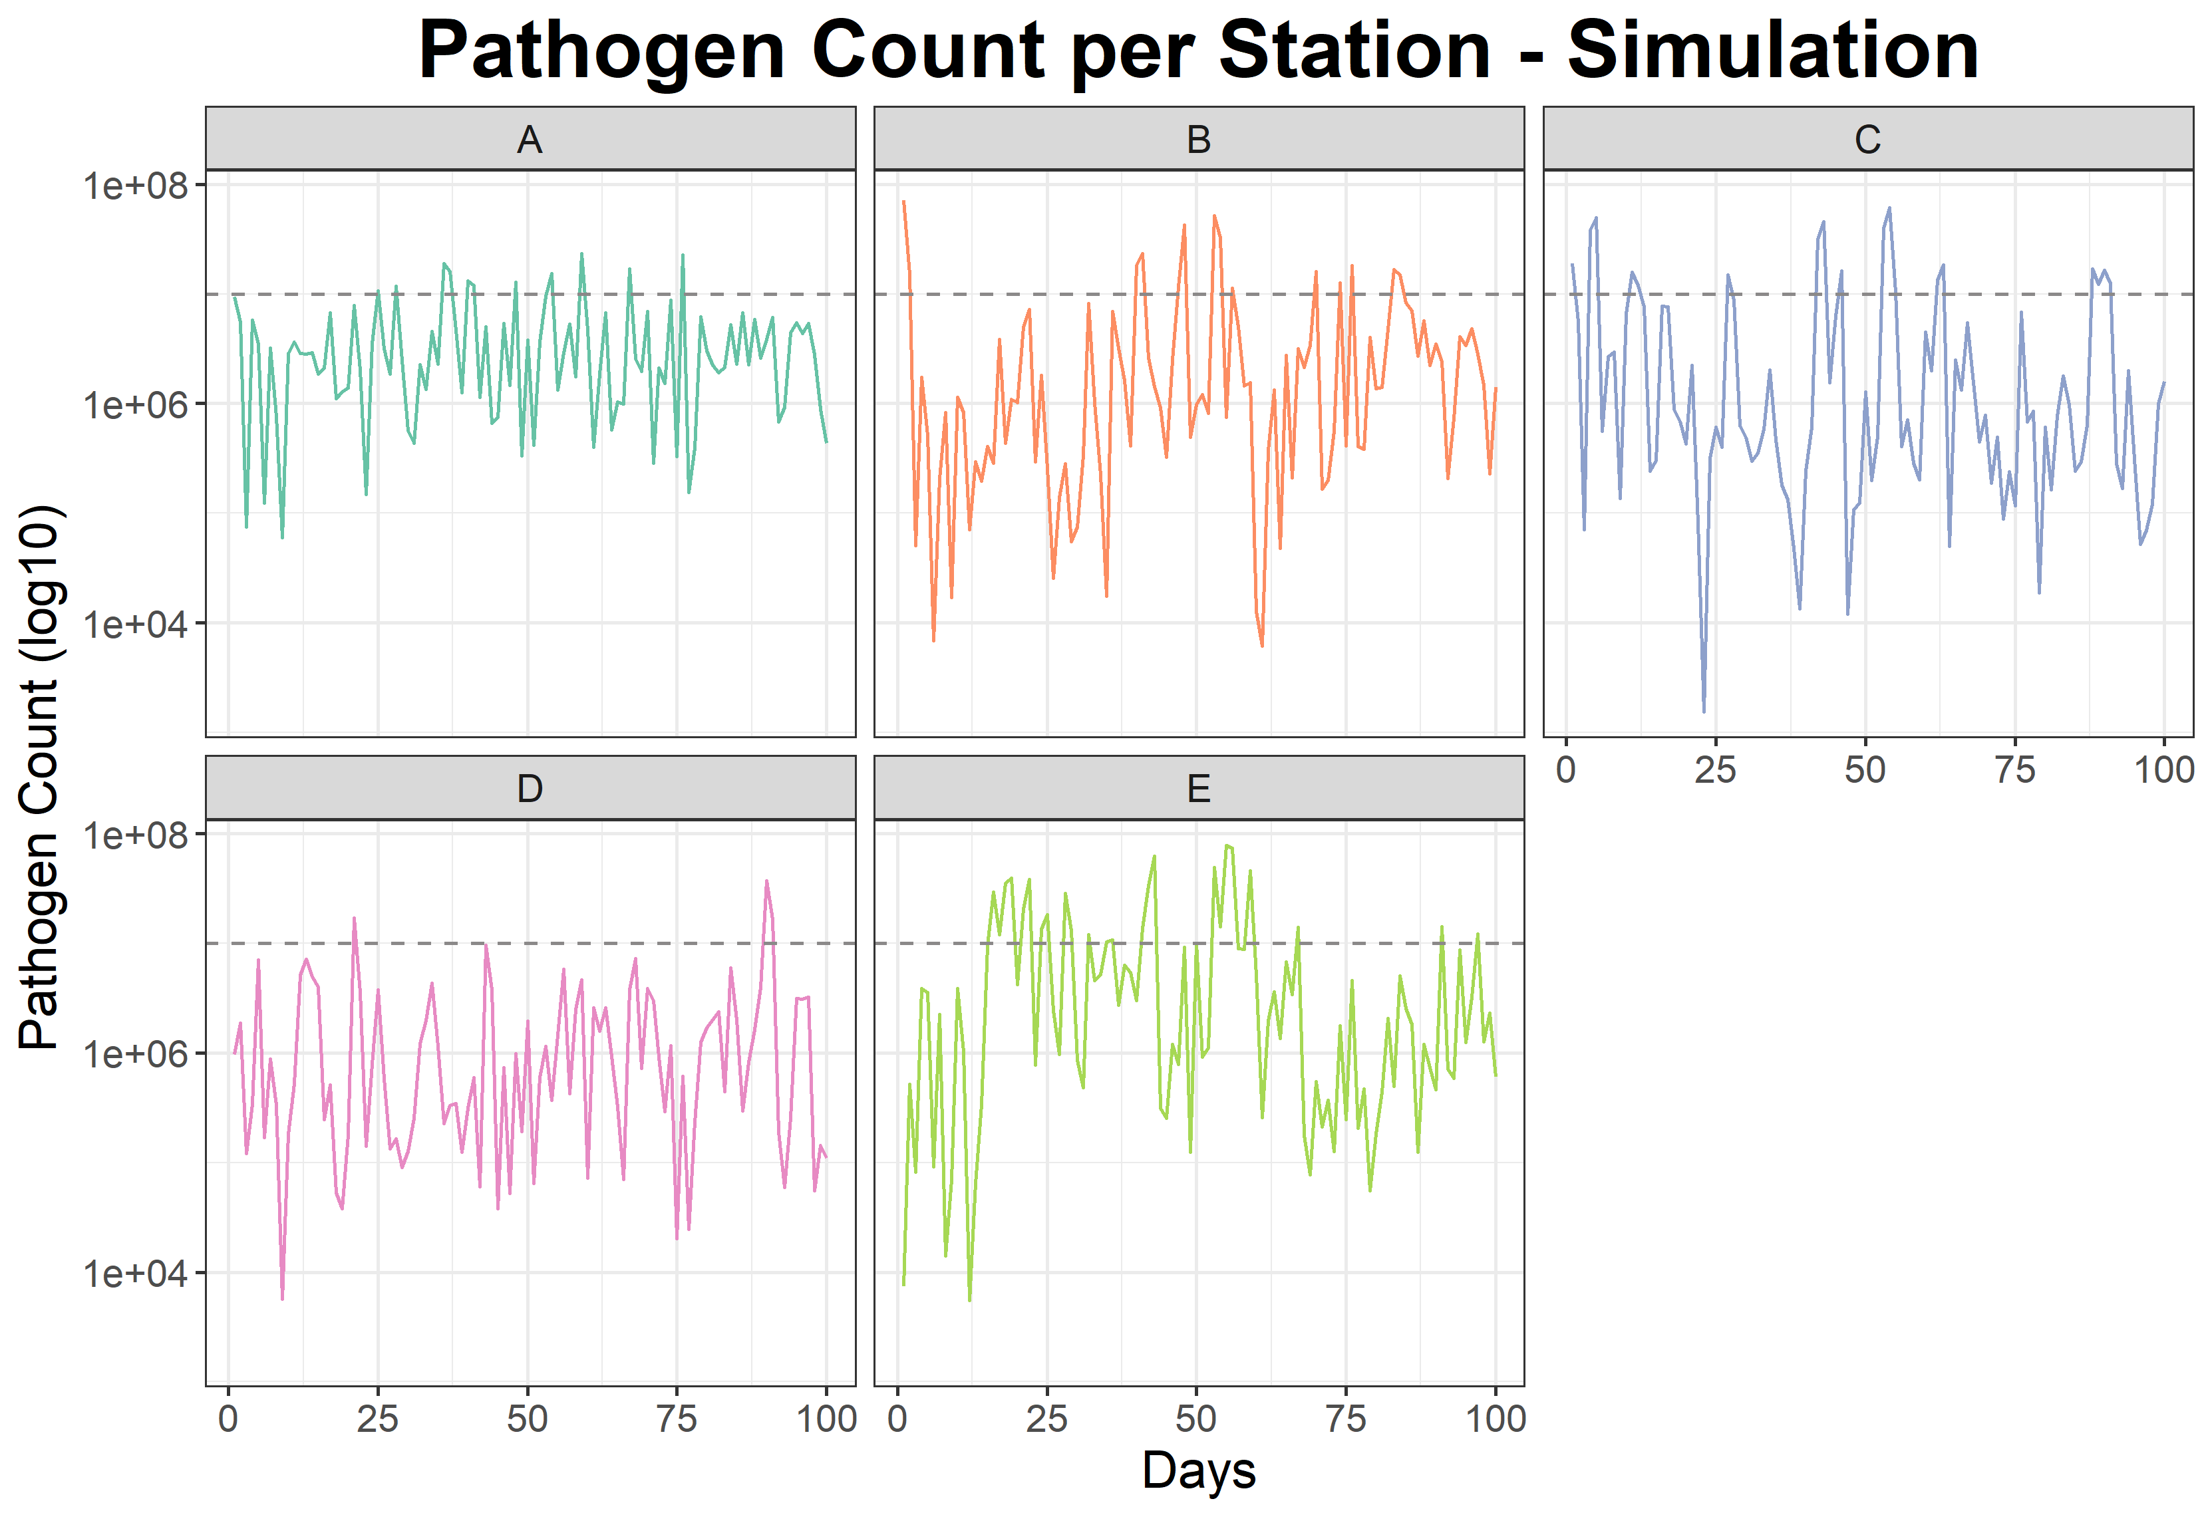
Positive sample: limit = 10^7

Slide 14
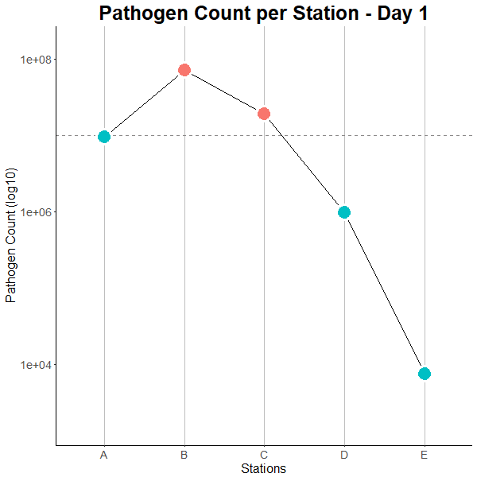
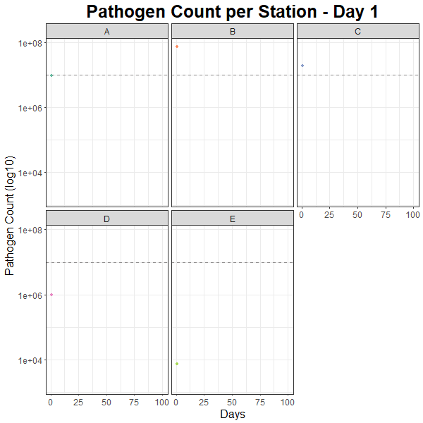
Simulation
C
E
D
B
Positive sample: limit = 10^7
A
Notes:
Animation: 2 frames per second (R setting .5)

Slide 15
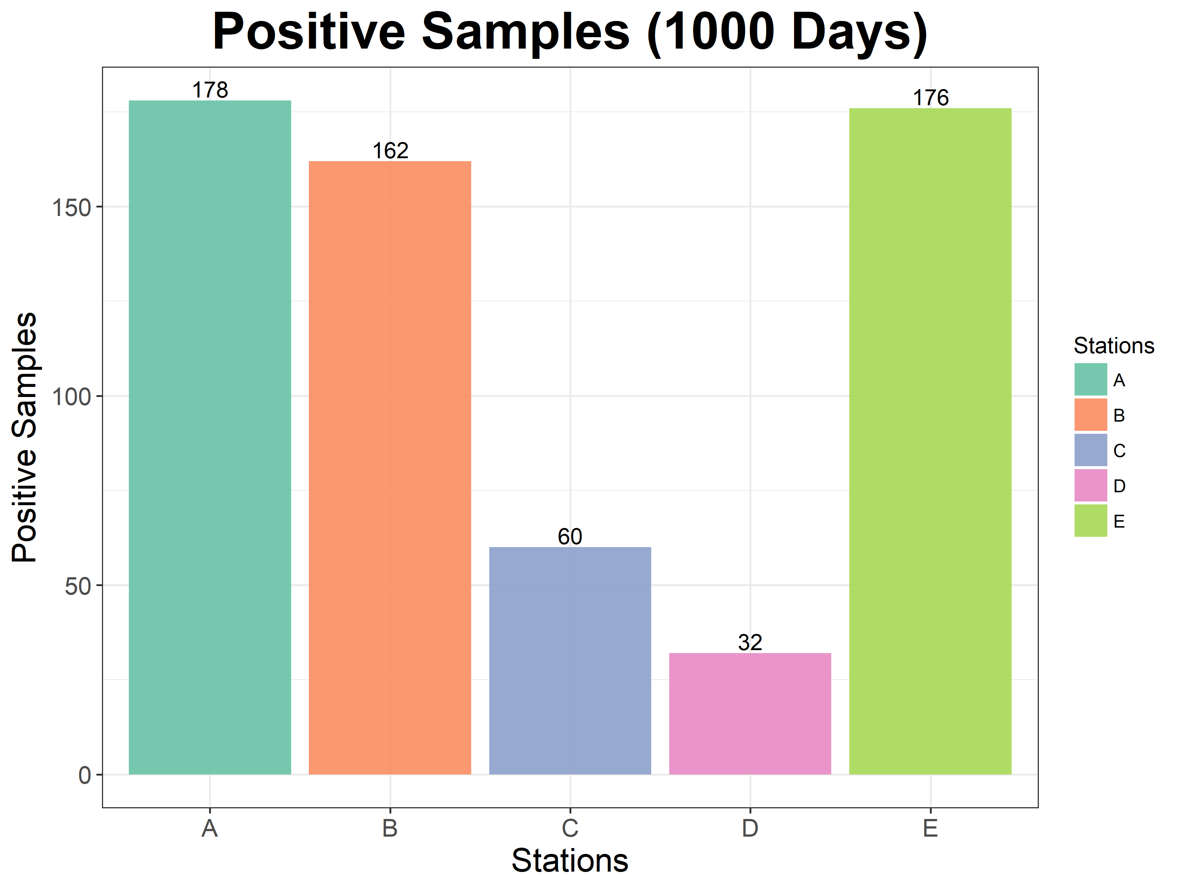
Positive sample: limit = 10^7

Slide 16
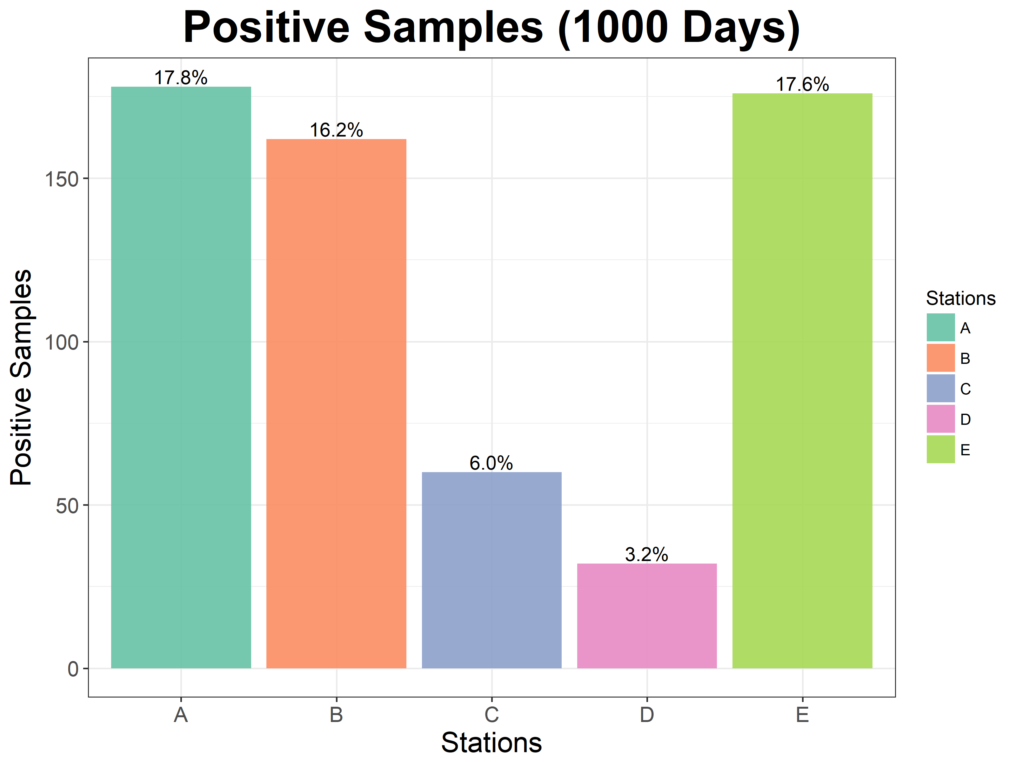
Positive sample: limit = 10^7

Slide 17
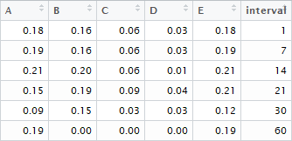
Sampling Intervals
i.e.: If a sample is taken every 14 days (in the 1000 days timespan), 21% of the samples taken at station A would be positive.
Positive sample: limit = 10^7

